Slide 1

You can do anything with PowerShell but should you?
Mark Gossa
Infrastructure Engineering Lead
Vanquis Bank

Slide 2
things to not Do with PowerShell
Get-AdUser -Filter * | Remove-AdUser -Confirm:$false
Get-AdComputer -Filter * | Remove-AdComputer -Confirm:$false
Get-VM | Remove-VM –Confirm:$false –RunAsync –DeletePermanently
Get-AzResourceGroup | Remove-AzResource -AsJob -Force -Confirm:$false
Start-Invasion

Slide 3

About me
Mark Gossa
Twitter: @markgossa
Blog: https://markgossa.blogspot.com
GitHub: https://github.com/markgossa

Slide 4
Outline
Can I do my entire job with PowerShell?
What other tools are out there?
PowerShell in a Serverless world
When to use PowerShell

Slide 5
Can I do my entire job with PowerShell?
Task | Can we do it with PowerShell?
Provisioning infrastructure (Azure, VMware) | Yes
Changing infrastructure | Yes
Windows Configuration | Yes
Deploying application code | Yes
Writing Azure Functions | Yes
Approving stuff by email | Yes
CI/CD pipeline | Yes
Create design docs | Need to think this through
Conference calls/meetings | Need to think this through more

Slide 6
Provisioning infrastructure
Demo: PowerShell vs Terraform
Notes:
PowerShell is simpler and quicker with less manual steps

Slide 7
Provisioning infrastructure
Demo: PowerShell vs Terraform
PowerShell seems simpler
PowerShell seems quicker
PowerShell has less manual steps
Notes:
PowerShell is simpler and quicker with less manual steps

Slide 8
Changing Infrastructure
Demo: PowerShell vs Terraform

Slide 9
Changing Infrastructure
Demo: PowerShell vs Terraform
PowerShell and Terraform are similar (time, complexity)
PowerShell is not idempotent
Can’t pass complex objects into Terraform
Limited language features in HCL
Notes:
HCL and ARM templates are not scripting or programming languages. They’re declarative which means limited features e.g. loops, conditionals, complex objects e.g. list of maps

Slide 10
Azure ‘DSC’ Attempt
Demo: Attempt to make idempotent Azure PowerShell module

Slide 11
Azure ‘DSC’ Attempt
Demo: Attempt to make idempotent Azure PowerShell module
How should it behave? (e.g. rename RG)
Who will maintain it?
Are we just recreating the Terraform/ARM Template wheel?

Slide 12
Windows Configuration
Demo: PowerShell vs PowerShell DSC

Slide 13
Windows Configuration
Demo: PowerShell vs PowerShell DSC
IaC PowerShell scripts should be idempotent
PowerShell DSC is already idempotent

Slide 14
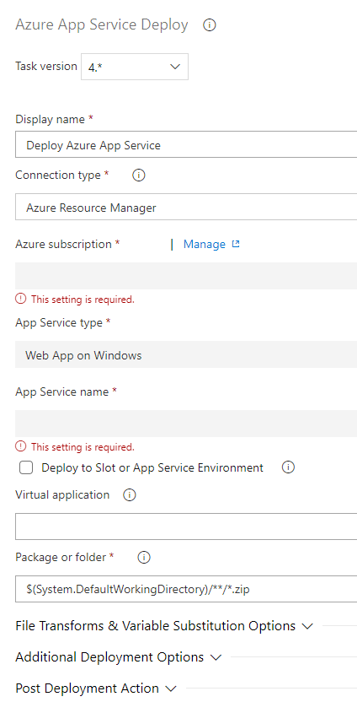
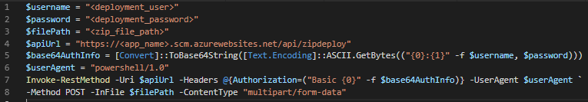
Deploying application code
PowerShell vs Azure DevOps
Azure DevOps tasks are simpler
Azure DevOps tasks are already written and don’t need maintenance

Slide 15
Writing Azure Functions
Language | Azure Functions v1 | Azure Functions v2
PowerShell | Experimental | Private preview
C# .NET Framework | GA | Not supported
C# .NET Core | Not supported | GA
https://docs.microsoft.com/en-us/azure/azure-functions/supported-languages
Notes:
For PowerShell – use Azure Automation account instead
Scaling limitations with experimental languages

Slide 16
Approving stuff by email
Demo: Outlook and PowerShell

Slide 17
CI/CD Pipelines
Approvals?
Auditing?
Storing artefacts?
History of deployments?
Use Azure Pipelines (incl built in tasks)

Slide 18
PowerShell in a Serverless world
Application Code - probably running .NET or other
Terraform to deploy infrastructure
No servers = no Windows configuration
Azure Pipelines for CI/CD
Is PowerShell needed?

Slide 19
When to use PowerShell?
PowerShell glue:
Where Terraform and ARM Templates can’t do it
Adding logic to declarative languages
Interfacing between different tools
Creating dynamic Ansible inventory (Object > JSON > YAML)
Automated testing with Pester
Windows configuration
Ad-hoc bulk/scheduled tasks
Notes:
Terraform and ARM templates can’t get Azure function keys
HCL/ARM templates are not meant to have complex logic – use PowerShell
Interfacing between Ansible, Terraform, Azure DevOps
Dynamic Ansible inventories – dynamically generate a list of server names and properties from various sources via JSON
App integration tests call API and pass but infrastructure built wrong
Ad-hoc reporting, daily checks, bulk AD user changes

Slide 20
Summary
Can we do everything with PowerShell?
When to use other tools (Azure DevOps, Terraform, ARM Templates etc)
PowerShell in a Serverless world
When to use PowerShell

Slide 21

Thank you!
Mark Gossa
Twitter: @markgossa
Blog: https://markgossa.blogspot.com
GitHub: https://github.com/markgossa

